Slide 1
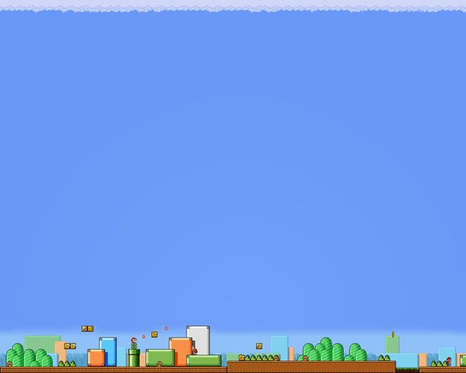
PROJECT:CAR GAME
Team Members:
KASHIFA KAWAAKIB HUSSAIN (180041227)
IFRAD TOWHID KHAN (180041225)
MD.SHAKIB UR RAHMAN (180041211)
1

Slide 2
Timeline before:
Prepare the pseudo code of the game
Expansion of the tracks to three or four lanes
Debugging and Testing
Addition of some ASCII arts
The first prototype of the game
15.07.19
12.08.19
09.09.19
Final
Submission
26.08.19
15.10.19
29.07.19
2

Slide 3
We are already ahead of our timeline!!!
3

Slide 4
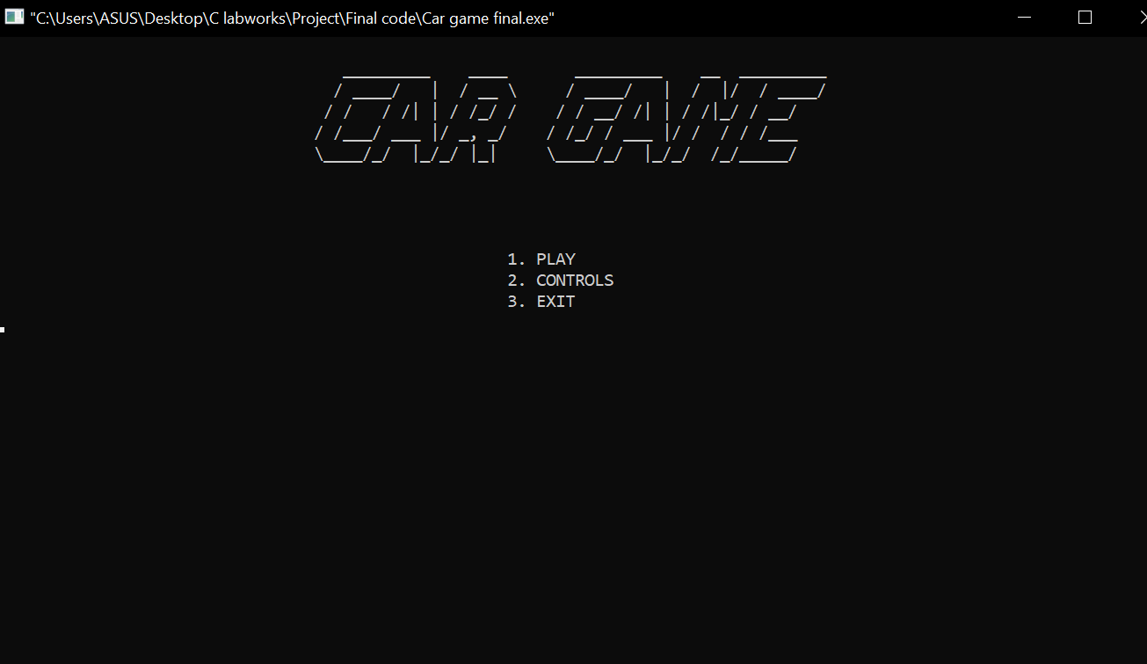
4

Slide 5
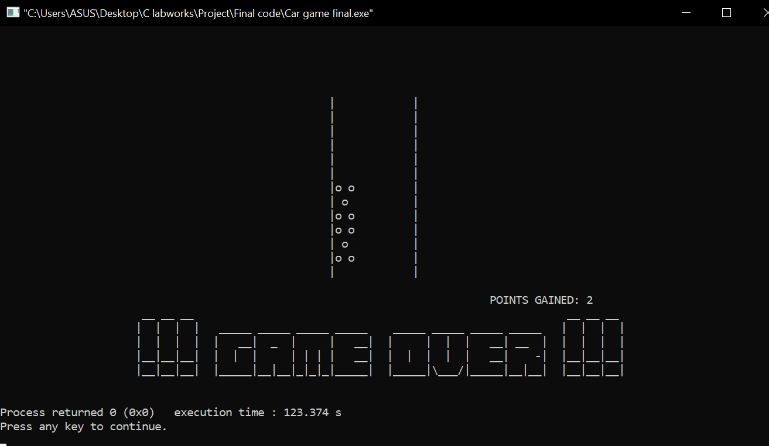
5

Slide 6
PROGRESS AND CHANGES AFTER FIRST PRESENTATION:
1. Added ASCII art.
2. Converted the track from 2 to 4 lanes.
3. Added a starting interface.
6

Slide 7
4. Added a difficulty algorithm.
5. Added sound.
6. Graphics integration on progress.
7

Slide 8
Future works:
Integration of some graphics and create a proper theme of the game.
8

Slide 9
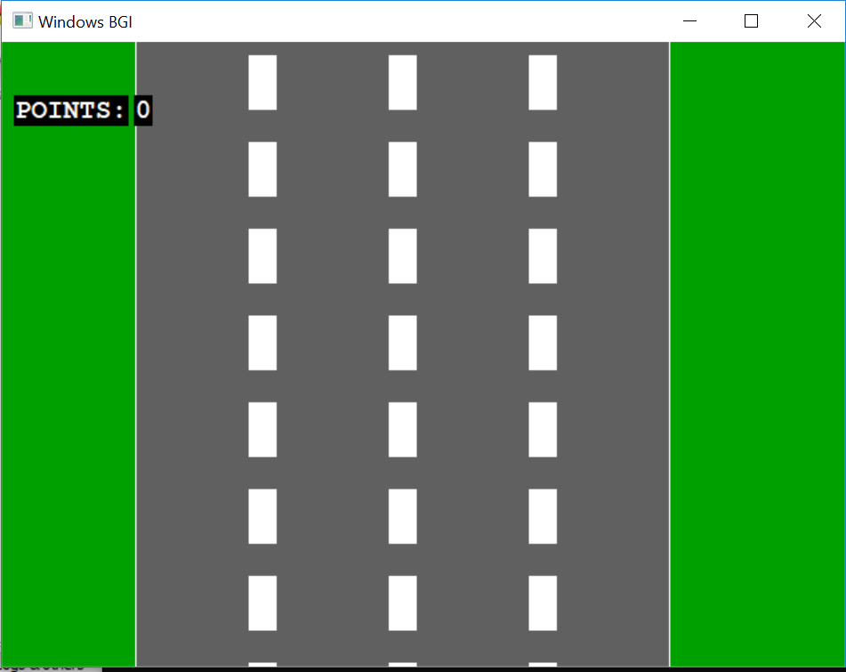
9

Slide 10
Thank you
10

